Slide 1
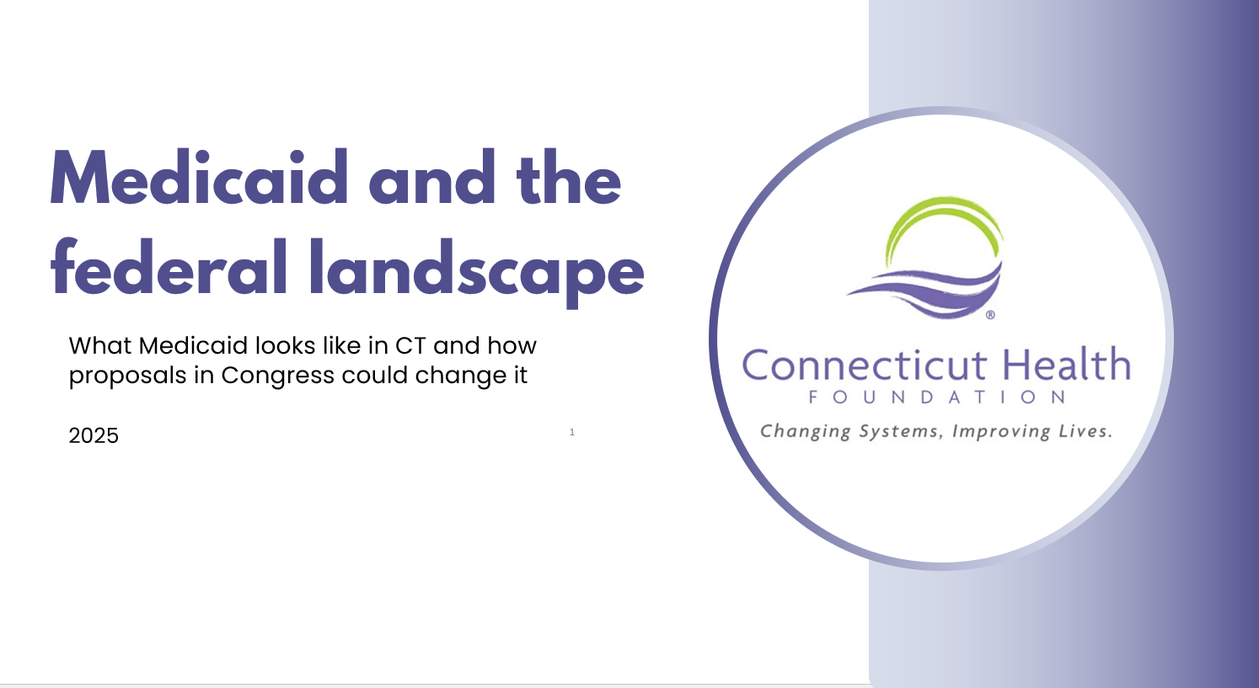
Medicaid in CT:
What to know about HUSKY

Slide 2

Overview
  What is Medicaid?
  Who’s covered?
  Medicaid in CT: HUSKY A, B, C & D
  Who runs Medicaid
  Medicaid payment

Slide 3
What is Medicaid?
Medicaid is health insurance.
Medicaid is the largest source of health insurance in the U.S.
  71 million people covered.
Medicaid goes by a lot of different names across the country.
  In CT, it’s called HUSKY.
Medicaid is NOT Medicare.
  But some people with Medicare also have Medicaid coverage.
  Medicare is insurance for people aged 65+ and people
  with disabilities.
Notes:
Enrollment as of December 2024: https://www.medicaid.gov/medicaid/program-information/medicaid-and-chip-enrollment-data/report-highlights

Slide 4
Who is Medicaid for?
Medicaid covers
low-income residents and
people with disabilities
Family size
1
2
3
4
5
Adults
  The income limit for kids is higher than adults.
  In some families, kids have HUSKY and parents do not.
  The income limit for people with disabilities is lower.
$21,597
$27,918
$36,777
$44,367
$51,957
Children
NA
$42,511
$53,566
$64,621
$76,676
Pregnant
People
NA
$55,624
$70,089
$84,554
$99,019
Notes:
Federal poverty guidelines: https://aspe.hhs.gov/topics/poverty-economic-mobility/poverty-guidelines
Adult eligibility is 138% of the federal poverty level (FPL).
Child eligibility is 201% of FPL (for HUSKY A).
Pregnant people’s eligibility is 263% FPL.
For people with disabilities and seniors with Medicare, the eligibility level is 105% FPL.

Slide 5
You know someone with Medicaid (probably many)
In CT, Medicaid covers:
  More than 900,000 people
  41% of births
  More than 1 in 3 public school students
  More than 1 in 3 people who work in child care
  2 in 3 nursing home residents
  People in every city and town in the state
Notes:
Medicaid coverage in public schools: https://ccf.georgetown.edu/2025/03/17/medicaid-chip-coverage-in-connecticut-school-districts-2019-2023/
Medicaid coverage in early childhood workforce: https://ccf.georgetown.edu/2025/04/21/medicaid-is-a-critical-support-for-the-early-childhood-education-workforce/
Other data: https://files.kff.org/attachment/fact-sheet-medicaid-state-CT

Slide 6
Anyone who qualifies can get coverage
Medicaid is an entitlement.
  Anyone who meets the qualifications can get coverage.
  This can make costs a bit unpredictable from year to year.
  This is different from government programs that have fixed budgets. If those programs run out of money, they can stop serving people. (Medicaid does not.)
Some lawmakers have tried to change that.
Past efforts to cut Medicaid have included shifting to a system with a set amount of funding (block grants) or a spending limit for each person (per-capita caps).
  This could result in big cuts to Medicaid spending (and coverage).
  This approach is NOT part of the law that passed in July 2025.

Slide 7
Medicaid in CT
Medicaid in CT is called HUSKY.
There are 4 main portions – HUSKY A, HUSKY B, HUSKY C, and HUSKY D.
  Each one differs in who is covered, the income limit, and the amount the federal government pays toward this coverage.
  There are some additional, smaller portions of HUSKY, such as coverage for people with breast or cervical cancer and limited coverage of family planning services.

Slide 8
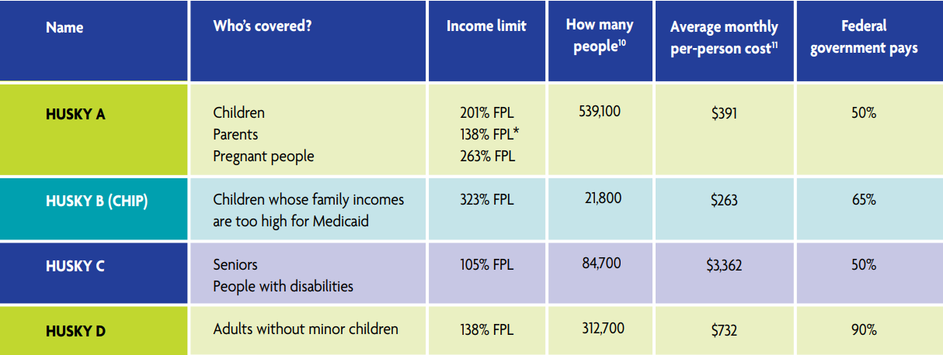
Medicaid in CT

Slide 9
HUSKY A
HUSKY A covers the most people of any part of Medicaid.
There are different eligibility limits for parents, kids, and pregnant people.
Who it covers
People
covered
Average monthly per-person cost
Income limits
Feds pay
Parents
138% FPL
539,100
$391
50%
Kids
201% FPL
Pregnant people
263% FPL
Notes:
Cost and enrollment data is as of fall 2024. Source: https://cga.ct.gov/app/related/20250226_2025%20Subcommittee%20Documents/20250317_Human%20Services/Medicaid%20Program%20Exp.%20Enrollment%20Update.pdf

Slide 10
HUSKY B
HUSKY B is the Children’s Health Insurance Plan (CHIP), not Medicaid.
It covers kids with family incomes above the Medicaid limit.
People
covered
Average monthly per-person cost
Who it covers
Income limits
Feds pay
Kids
under 19
201% to 323% FPL
21,800
$263
65%
Notes:
Cost and enrollment data is as of fall 2024. Source: https://cga.ct.gov/app/related/20250226_2025%20Subcommittee%20Documents/20250317_Human%20Services/Medicaid%20Program%20Exp.%20Enrollment%20Update.pdf

Slide 11
HUSKY C
HUSKY C covers low-income seniors and people with disabilities. Many people with HUSKY C receive long-term care in nursing homes or at home.
HUSKY C has the lowest income limit to qualify.
Because people with HUSKY C have high medical needs, it has the highest costs per person.
People
covered
Average monthly per-person cost
Who it covers
Income limits
Feds pay
Seniors
People with disabilities
105% FPL
84,700
$3,362
50%
Notes:
Cost and enrollment data is as of fall 2024. Source: https://cga.ct.gov/app/related/20250226_2025%20Subcommittee%20Documents/20250317_Human%20Services/Medicaid%20Program%20Exp.%20Enrollment%20Update.pdf

Slide 12
HUSKY D
HUSKY D was created under the Affordable Care Act (also known as Obamacare).
It covers adults under 65 who do not have minor children.
This group is also known as the Medicaid expansion.
The federal government pays 90% of the cost of this coverage.
People
covered
Average monthly per-person cost
Who it covers
Income limits
Feds pay
Adults without minor children
$732
138% FPL
312,700
90%
Notes:
Cost and enrollment data is as of fall 2024. Source: https://cga.ct.gov/app/related/20250226_2025%20Subcommittee%20Documents/20250317_Human%20Services/Medicaid%20Program%20Exp.%20Enrollment%20Update.pdf

Slide 13
How does CT cover undocumented residents?
State HUSKY A
  CT covers kids up to age 16 regardless of immigration status, if their families meet income limits.
  Kids who get covered before age 16 can stay covered until they turn 19.
  This is entirely funded by the state.
Pregnancy and postpartum coverage
  CT provides HUSKY coverage to people who are pregnant and up to 12 months postpartum, regardless of immigration status.
Emergency Medicaid
  The federal government pays hospitals for providing emergency treatment to low-income people, regardless of immigration status.

Slide 14
Who runs Medicaid?
Medicaid is run by the state and federal government.
  The federal government sets rules; states run their Medicaid programs within those rules.
  Each state’s Medicaid program works differently.
  Certain decisions about Medicaid are up to states, and others require federal approval.
The state agency that runs Medicaid in CT is the Department of Social Services.

Slide 15
Who pays for Medicaid?
The state and federal governments share the cost.
States spend money on Medicaid, and the federal government reimburses a percentage of the costs.
  In CT, the federal government pays 50% of the cost for most coverage. In states with lower incomes, the feds pay more.
  For some coverage, the feds pay every state more. (For example, for HUSKY D/expansion coverage, the feds pay 90% of the cost.)
  In 2023, Medicaid in CT cost $10.4 billion. The federal government paid 63% of that cost.
Notes:
Spending data: https://www.kff.org/medicaid/state-indicator/total-medicaid-spending/?currentTimeframe=0&sortModel=%7B%22colId%22:%22Location%22,%22sort%22:%22asc%22%7D
FMAP by state: https://www.kff.org/medicaid/state-indicator/federal-matching-rate-and-multiplier/?currentTimeframe=0&sortModel=%7B%22colId%22:%22Location%22,%22sort%22:%22asc%22%7D

Slide 16
The federal payment rate is an important tool
Key term: FMAP (federal medical assistance percentage)
FMAP is the percent of a state’s Medicaid costs that the federal government pays.
The FMAP is a big lever the federal government can use to increase (or decrease) funding to states.
  Example: During the COVID-19 pandemic, the federal government increased the FMAP for states by 6.2 percentage points.
  This helped states pay for Medicaid at a time when more people needed coverage and states were collecting less tax money since fewer people were working.
  Congress has recently considered lowering the FMAP for certain
states.
Notes:
For more on FMAP and Medicaid financing: https://www.kff.org/medicaid/issue-brief/medicaid-financing-the-basics/

Slide 17
Where does Medicaid funding go?
Medicaid funding goes to health care providers – hospitals, doctors’ offices, clinics, community health centers, dentists, pharmacies, etc.
Medicaid payments have ripple effects on the economy. Health care providers employ people, whose incomes contribute to the economy.
In CT, Medicaid covers:
  More than 20% of hospital discharges
  60% of community health center patients
Notes:
Hospital data: https://portal.ct.gov/ohs/-/media/ohs/hsp/ohs_financial-stability-report_fy-2022.pdf
Community health center data: https://www.kff.org/other/state-indicator/chc-patients-by-payer-source/?dataView=1&currentTimeframe=0&sortModel=%7B%22colId%22:%22Location%22,%22sort%22:%22asc%22%7D

Slide 18
Long-term outcomes from Medicaid coverage
Research has linked Medicaid coverage of children and pregnant women to long-term health and economic benefits.
These include:
  Better health during adulthood: improved overall health, reduced obesity, decreased hospitalizations, lower rates of disability, and reduced mortality.
  Greater educational attainment: higher reading test scores, reduced high school dropout rates and increased likelihood of college attendance and degree completion.
  Increased employment, higher earnings, higher tax payments in adulthood.
Notes:
See more about long-term outcomes: https://www.cthealth.org/publication/medicaids-role-in-connecticuts-economy-health-system-and-budget/

Slide 19
Long-term outcomes from Medicaid coverage
Research has linked the Medicaid expansion under the Affordable Care Act (to cover more low-income adults) to positive outcomes.
These include:
  More early-stage cancer diagnosis and treatment.
  Improved access to medical care and behavioral health treatment.
  Less medical debt and fewer unpaid bills among low-income
people.
Studies have also found that gaining Medicaid coverage made it easier for people to look for jobs or continue working, which benefits individuals as well as the overall economy.
Notes:
See more about the outcomes of the Medicaid expansion: https://www.kff.org/report-section/the-effects-of-medicaid-expansion-under-the-aca-updated-findings-from-a-literature-review-report/
https://aspe.hhs.gov/sites/default/files/documents/effbde36dd9852a49d10e66e4a4ee333/medicaid-health-economic-benefits.pdf

Slide 20
Learn more
Medicaid in CT, a curated set of resources from the Connecticut Health Foundation:
https://www.cthealth.org/topic-guides/medicaid-in-ct/
Medicaid resources from KFF, a national organization focused on health policy that provides background information and updates on recent changes: https://www.kff.org/medicaid/
There’s more to Medicaid, from the CT Department of Social Services:
https://www.myplacect.org/medicaid/
Medicaid information from Families USA, which advocates for health care consumers:
https://familiesusa.org/our-work/medicaid/

Slide 21
How to apply
Looking for Medicaid coverage?
To apply or see if you’re eligible, visit the CT Department of Social Services website:
https://connect.ct.gov/access/jsp/access/Home.jsp
You can also call the Department of Social Services: 1-855-626-6632

