Slide 1
Adaptive Leadership Development Program Overview for Leaders
Connecticut Health Foundation
Bill McKendree
mckendree@theclariongroup.com
860-232-3667 x113
Wendy Helmkamp
helmkamp@theclariongroup.com
860-232-3667 x115
January 6, 2017

Slide 2
Content
1
Adaptive Leadership Framework
Roles and Expectations
Sample Assessment Page
Sample Report Page
Development Plan
Assessor Selection Guidelines
Timeline
2
3
4
5
6
7

Slide 3
Adaptive Leadership Framework Overview

Slide 4
Adaptive Leadership Framework
Why Develop Skills at Adaptive Leadership?
Effectiveness at affecting health policy, especially in times of complexity and rapid change, will call upon personal leadership capabilities as much as it will knowledge of policy-making, strategic planning and the politics of change.
This Development Program will give you the opportunity to be introspective and reflective about your capabilities in driving and affecting change as health advocates.
Igniting Possibility
Adaptive Leadership
Creating Alignment
Ensuring Viability

Slide 5
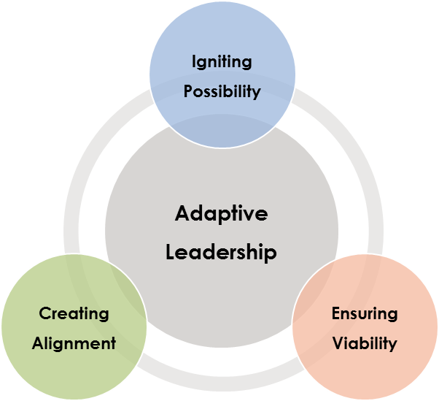
Adaptive Leadership Components and Attributes
Igniting Possibility
Conceiving and creating an environment that will ignite a sense of possibility and provide deeper meaning and intrinsic relevance to the people who join together to create it.
Higher Purpose
Adaptation
Enablement
Creating Alignment
Linking all the organizational components together, while they are in constant motion, so everyone understands how what they do day-in and day-out ties to the vision, mission or strategy.
Clarity
Transparency
Integrity
Standards
Accountability
Ensuring Viability
Designing, managing, and influencing organizational eco-systems and stakeholders’ involvement to ensure their staying power, integrity and efficiency in support of short- and long-term viability.
Market and Social Relevance
Sound Logic
Collective Capability

Slide 6
Igniting Possibility
Higher Purpose | Creates and formalizes a higher purpose for working together on goals or objectives. Ensures the purpose is aspirational and provides intrinsic meaning for employees, colleagues and/or key stakeholders. Champions and communicates the higher purpose to all involved. Engages all involved to reach their collective highest potential when working on shared goals.
Adaptation | Constantly surveys and monitors the environment and responds quickly to changes in the environment that could affect the goals or objectives. Leverages relevant information from the environment and makes adjustments accordingly; plans, goals and commitments are modified to reflect changes in the environment. Develops and implements systems/processes that help him/her be more dynamic and responsive to the environment. Is risk tolerant and open to using experiments to test and try out ideas. Sees and works through boundaries. Is curious and open to the emergence of new ideas and perspectives.
Enablement | Recognizes and reinforces good performance and takes action quickly with others whose contributions are faltering. Invests time and energy in the success of others who are involved in achieving goals or objectives. Stimulates stakeholder engagement by involving them in creating shared goals or objectives and giving them responsibility to contribute to the achievement of those goals or objectives. Inspires people to go beyond their comfort level to achieve the highest possible outcomes. Values people within his/her organization as well as outside; treats others with respect and ensures everyone has the opportunity to be the best they can be. Is highly collaborative and receptive to hearing different points of view.

Slide 7
Creating Alignment
Clarity | Ensures the goals or objectives have been communicated in a way that ensures everyone has clear roles. Ensures the strategy for the achievement of the goals is clear, and that it is communicated in a compelling way. Ensures all involved in achieving the goals understand how their work fits and the value that they add.
Transparency | Establishes a clear decision-making process is in place; all involved understand how and why decisions are made. Instills a sense of openness and candidness among all involved and that there are few secrets and hidden agendas; difficult issues get discussed. Creates space for unpopular or dissenting opinions to be heard, and an atmosphere where everyone matters.
Integrity | Models a clear ethical standard. Addresses and may administer consequences when someone crosses the line as to what is acceptable. Acts consistently in accordance with the rules and/or norms he/she espouses to others (i.e., they walk their talk), even when it means personal risk. Is honest in his/her communications.
Standards | Sets clear standards for performance when appropriate, and expects all involved to operate at a very high standard. Ensures the right people are engaged in the right work and takes swift action to make sure there is a good person/role fit.
Accountability | Ensures all involved have clear personal commitments and objectives. Ensures the alignment of commitments and objectives among all involved are well understood by all. Exhibits a sense of “all being in this together.” Adopts a “buck stops here” mentality and invites constructive escalation of issues.

Slide 8
Ensuring Viability
Market and Societal Relevance | Addresses a clear need when establishing the goals or objectives. Ensures there is a clear connection between the need and the work that is being done to address the need. Ensures all involved have a deep understanding of the needs of those who will benefit from or be impacted by achieving the goals or objectives. Measures the level of impact achieved and adjusts accordingly when desired impact is not reached.
Sound Logic | Brings together team capabilities based on the logic of the goals or objectives. Ensures there is a process for determining priorities supporting the goals, and the priorities are well understood by all involved. Makes appropriate tradeoffs when making decisions about priorities. Strives to maximize value and impact with lowest possible cost. Demonstrates awareness of the broader context and is able to see patterns that inform how to best achieve the goals or objectives.
Collective Capability | Ensures the particular mix of resources is adequate to drive the goals to success. Balances the competing concerns of various constituent groups. Establishes practices that drive equity and fairness for all stakeholders involved in achieving the goals. Ensures people have the information and resources they need to fulfill on their commitment to achieving the goals or objectives.

Slide 9
Adaptive Leadership Development Process

Slide 10
Who’s Involved and What’s Expected
Leader
Accountable for:
Identifying assessors to provide feedback on adaptive behaviors
Developing a plan for how to apply the assessment results in an initial feedback session (with input from coach and Clarion advisor)
Following through on developmental actions
Roles
Coach
Accountable for:
Providing help to Leaders on crafting development plans during the initial feedback session based on personal experience
Assisting with development activities as appropriate
Serving as a sounding board and checking in on progress
Clarion Advisor
Accountable for:
Helping the Leader interpret the assessment results during the initial feedback session
Providing support to the Leader on an ad hoc basis if needed
Facilitating “Fireside Chats” amongst all Leaders to share experiences
Helping the Leader assess progress and identify “what’s next” at the conclusion of the Academy

Slide 11
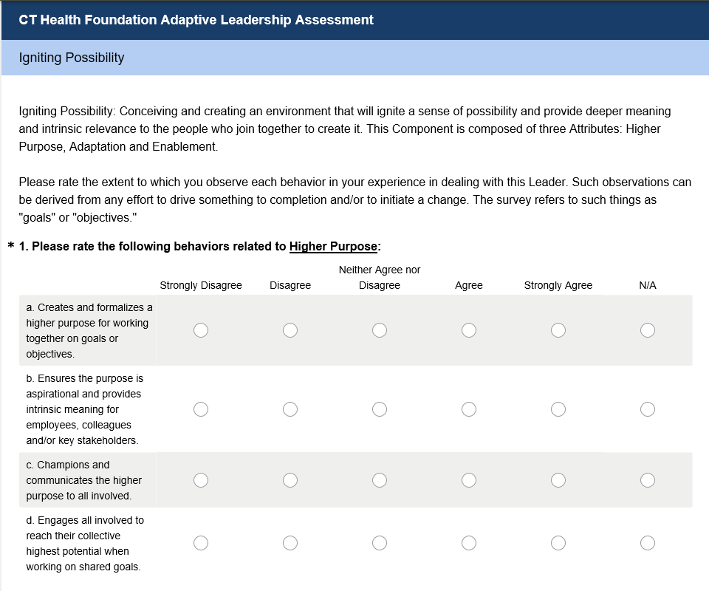
Sample Assessment
The assessment will consist of multiple sections for each Component of Adaptive Leadership. (One section is shown here.)
Assessors will confidentially rate the behaviors on a five point scale or indicate not applicable. There will also be a place to add comments at the end.

Slide 12
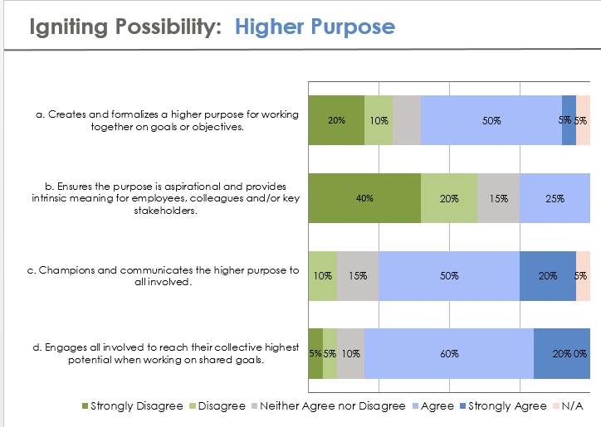
Sample Report
The Report will provide an aggregated view for each behavior from all assessors who provide feedback.
It will also highlight strengths and areas where the Leader can further develop his/her abilities.

Slide 13
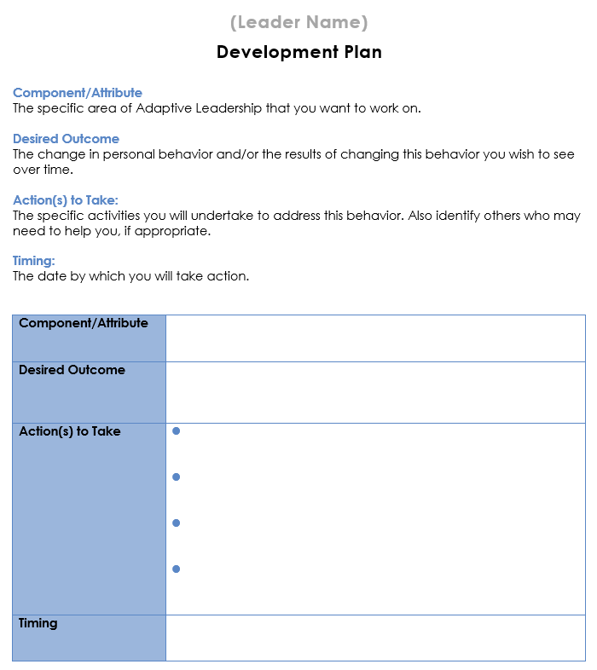
Sample Development Plan
The Development Plan is a tool for the Leader to get focused on the actions that s/he will take to strengthen his/her capabilities as an adaptive leader.
It will be a “living plan” that should be reviewed and adjusted over time.

Slide 14
Choosing Assessors
Leaders should select a minimum of 4 assessors (there is no maximum) who meet the following criteria:
Individuals who know the Leader most from a work perspective
Any colleague, whether it be a manager (strongly encouraged), board chair, executive director, peer, direct report or external work partner
Individuals who are intimately aware of how the Leader behaves with respect to the types of behaviors in the framework
Individuals who would like to help the Leader develop and will take the time to do a thorough assessment

Slide 15
Assessment & Development Timeline
Jan 9-13
Leaders request participation of assessors and send their e-mail addresses to camire@theclariongroup.com
Jan 30-Feb 10
The Clarion Group produces an Adaptive Leadership Report for each Leader
May, Sept, Jan ‘18
The Clarion Group facilitates an informal development experience exchange during Academy Seminars
Assessment
Distribution
Summary Report Completion
Adaptive Leadership Fireside Chats
2
4
6
1
3
5
Jan 6
The Clarion Group introduces the framework and development approach to Leaders; coaches will be present
Jan 16-27
Assessors electronically complete confidential assessment
Feb 13 – Mar 3
Leaders, Coaches and Clarion Advisor convene in person (ideally) for a two-hour feedback session
Adaptive Leadership Kick-Off
Assessment Completion
Feedback Sessions

Slide 16
Immediate Next Steps
Identify Assessors
Request Their Involvement
Communicate all assessor email addresses at once to camire@theclariongroup.com

Slide 17
Sample Communication
Dear ____,
As part of my participation in the Academy for Health Equity Advocacy & Leadership (AHEAL), I will have the opportunity to strengthen my skills as an adaptive leader through a personal development process. Effectiveness at affecting health policy, especially in times of complexity and rapid change, will call upon personal leadership capabilities as much as it will knowledge of policy-making, strategic planning and the politics of change.
The development process includes an assessment of my adaptive leadership skills. The results of this assessment will bring me greater clarity on my strengths and opportunities for development. I would like to know if you will assist me in this process by completing the assessment. Given our experience working together, your candid perspective will be most helpful. Your responses will remain confidential, since responses are kept anonymous.
Once I hear that you are able to complete this Assessment for me, I will provide your email to Kim Camire from The Clarion Group, the firm that is administering the assessment. Kim will then send you a link to the on-line survey. It should take approximately 20 – 25 minutes of your time. The deadline for completion is January 27.
Please let me know if you have any questions; otherwise, thank you in advance for taking the time and energy to participate in this process.
Regards,

